Slide 1
CS Robotics Seminar F16 (Week 1) – Sept. 19, 2016 “Shape Based Compliance in Locomotion” M. Travers, J. Whitman, P. Schiebel, D. Goldman, H. Choset Robotics Science and Systems (RSS) 2016
Presented By: Colin Rennie

Slide 2

Videos
Notes:
Composed 18 series-elastic joints
With rotary encoders to measure exerted forces and parse external forces from controls

Slide 3
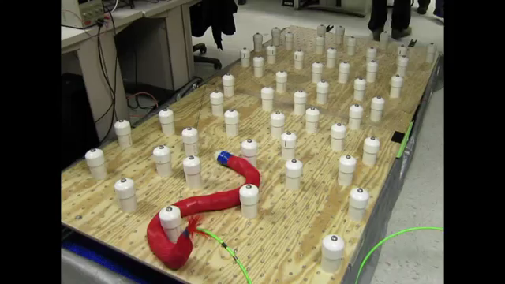
Videos
Notes:
Compliant

Slide 4
Outline
Background: Admittance Control and Compliance
Shape-Based Compliant Control
Whole Body Shape-Based Compliance (Snake)
Decentralized Shape Modulation

Slide 5
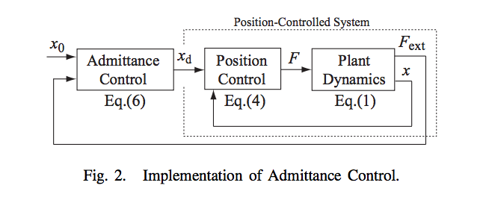
Background: Admittance Control
Admittance Control
Control approach which is the inverse of impedance control
Defines motions as a function of external force input
Figure: Ott, Christian, Ranjan Mukherjee, and Yoshihiko Nakamura. "Unified impedance and admittance control." Robotics and Automation (ICRA), 2010 IEEE International Conference on. IEEE, 2010.
Notes:
Impedance control defines forces as a result of external motions imposed by the environment
Admittance control defines motions as a result of external forces

Slide 6
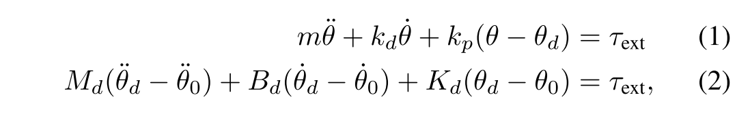
Background: Admittance Control
Example System Dynamics
System with θ ∈ R^{N}:
Nominal trajectory defined by θ₀
Eqn. 1 defines second order system dynamics, low level PD controller
Eqn. 2 defines forced spring-mass-damper linear dynamics of desired set points
Desired joint set points
Set Point Second Order Dynamics
Notes:
Allows us to define set point dynamics in response to sensed external forces
Equation (1) represents the controlled second-order dynamics for the system, where the low-level controller is a standard PD control law.
What makes this an admittance controller is that the desired set point θd in (1) has its own set of dynamics that adjust θd in response to external forcing, measured by τext. Equation (2) specifies that the desired joint signal θd has the linear dynamics of a forced spring-mass-damper, with a nominal trajectory defined by θ0
m is an inertia, kd and kp are positive gains, τext is the torque due to the external force, Md is an effective mass, Bd an effective damping, and Kd an effective spring constant.

Slide 7
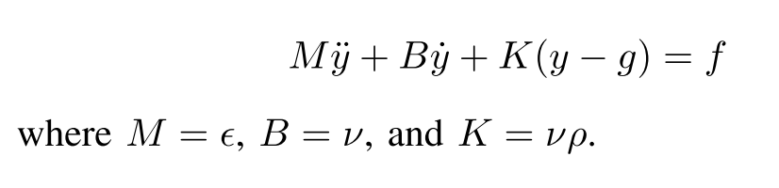
Background: DMPs
Dynamic Movement Primitive (DMP)
Generalized form of admittance control
ƒ is a forcing term, used to modulate response of y
Freedom in choosing ƒ is what makes this a more general form of admittance control
Admittance Control
(Eqn 2)
Dynamic Movement
Primitive
Notes:
The freedom in choosing f is what makes DMPs more general than admittance controllers.
An admittance controller can be thought of as a special case of a DMP, where the forcing signal f in (3) is explicitly a function of proprioceptively-measured environmental forces

Slide 8
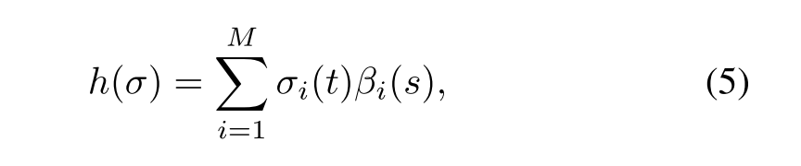
Shape-Based Compliant Control
Shape Functions
Composed of two elements:
(1) Shape bases
(2) Shape parameters
Linear Shape Functions
Maps a point (σ) in the shape parameter space Σ, into the joint space of a mechanism, i.e., h : Σ → R^{N}, where θ ∈ R^{N} defines the joint space for an N-joint mechanism
Shape Parameters
Shape Bases
Notes:
βi(s)’s are linearly independent shape basis func- tions. These basis functions spatially encode static joint-to- joint coordination, i.e., these basis functions encode static shapes for a particular mechanism. The expression for h in (5) can be used to map (1) and (2), that define an admittancecontroller in joint space, into an equivalent expression in the shape parameter space Σ using the following relationships
γ = {d, 0}; σd defines a desired shape parameterization and σ0 a nominal shape parameterization. The Jacobian matrixJ in (7) is an analytical Jacobian that arises from changing coordinates from the shape parameter space to the joint space [18].
Compliant control of shape parameters effectively equivalent to compliant control of joint angles, but the overall shapes a mechanism is allowed to take on are constrained to remain within a particular basis (specified by the β_{i}’s)
----- Meeting Notes (9/19/16 13:35) -----
change layout

Slide 9
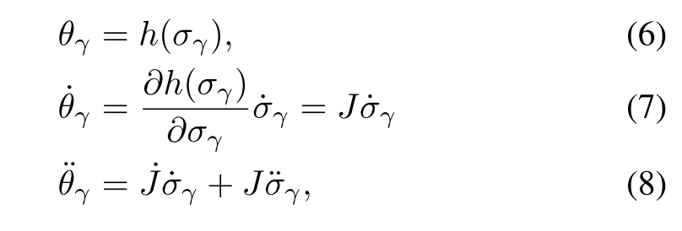
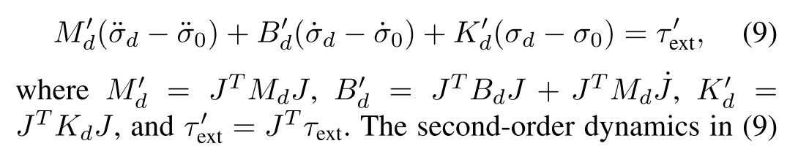
Shape-Based Compliant Control
Linear Shape Functions
Above can be used to map admittance control system equations into equivalent expressions in shape space via relationships:
Which results in DMP control equation:
Notes:
γ = {d, 0}; σd defines a desired shape parameterization and σ0 a nominal shape parameterization. The Jacobian matrixJ in (7) is an analytical Jacobian that arises from changing coordinates from the shape parameter space to the joint space [18].
Which they then turn into a DMP in shape space by substituting a forcing term
Equivalent to F = J tau_ext

Slide 10
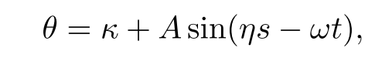
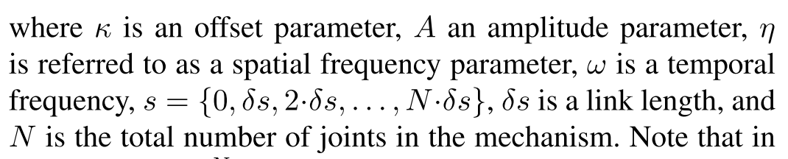
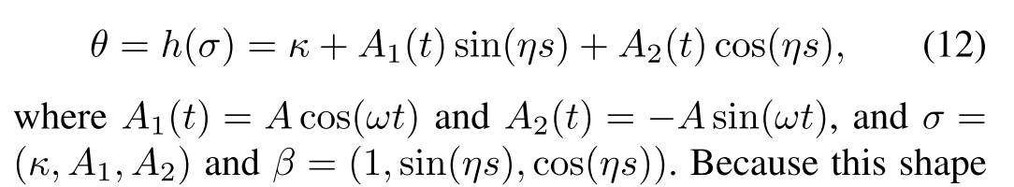
Whole Body Shape-Based Compliance
Hirose’s Serpenoid Model
Rewrite the above kinematic model into shape function form:
Notes:
Note that in(11), θ, κ, t ∈ RN, where κ and t are actually N ×1 vectors of ones multiplied by the corresponding parameter values, and sin() acts component-wise.
The serpenoid model in (11) is a whole-body kinematic model in the sense that changing any of the parameters κ, A, η, or ω changes the shape of the entire robot.
Because this shapefunction is linear in the elements of σ, a shape-based compliant controller of the form (9) can be derived and implemented on the snake robot hardware

Slide 11
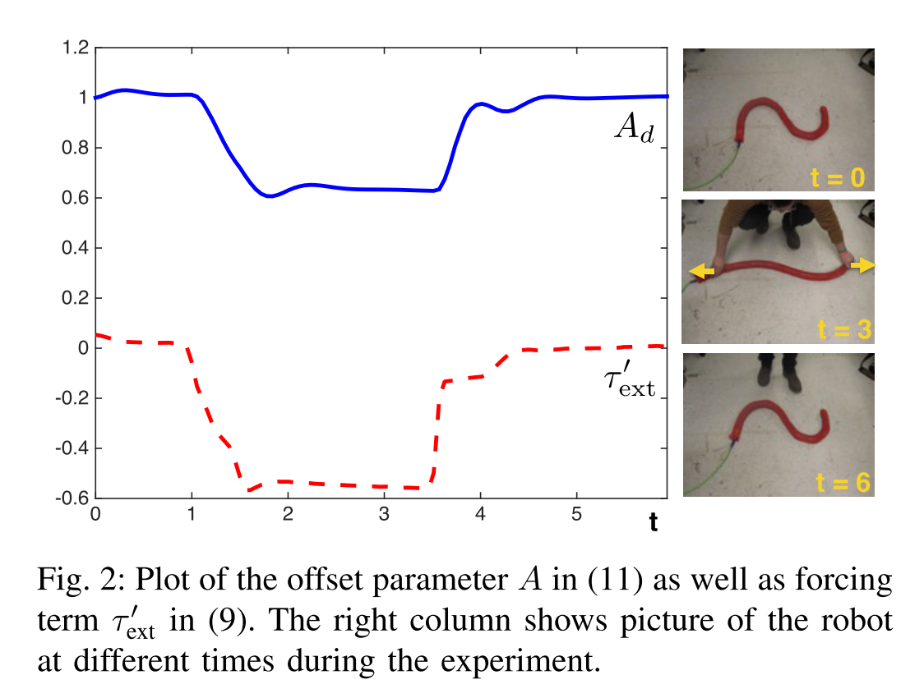
Whole Body Shape-Based Compliance
Amplitude parameter adapting to external forces

Slide 12
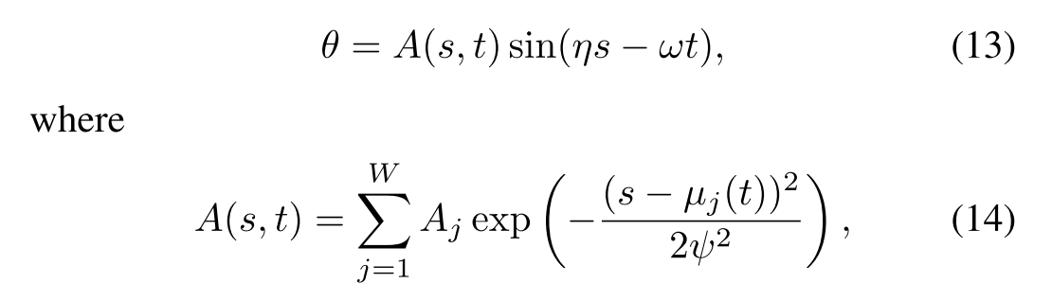

Decentralized Shape Modulation
Defining Spatial Activation Windows
Shape Function:
Window Center Locations
# Activation
Windows
Window Amplitudes
Window Widths
Notes:
For example, in the lower limit, selecting a single window located at each joint with a small window width effectively decouples shape modulation completely. In the upper limit, a single window located in the center of the mechanism with a large window width represents entirely coupled shape modulation.
additional freedom in (13) is the ability to specify how or if the activation windows move as a function of time. The method chosen in this work is to allow activation windows to move with the waveform sin(ηs − ωt) as it travels down the robot’s body
When each window center travels the distance that brings it to the original position of the window center in front of it, the window is recirculated back to its original position.
Additional constraints pass shape parameters from one window to the next at the times when the window center locations are recirculated.

Slide 13
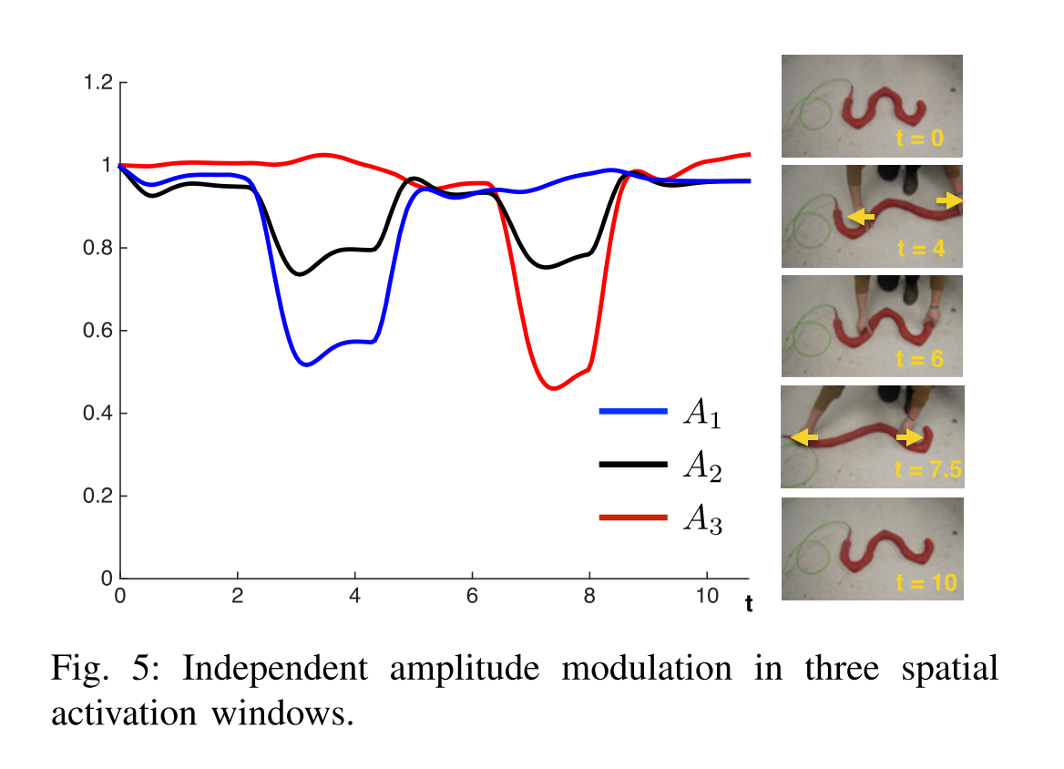
Decentralized Shape Modulation
Using 3 Windows, Ext. Force Effects on Amplitude Parameters
ω = 3
σ = (A₁, A₂, A₃)
η = 1.5

Slide 14
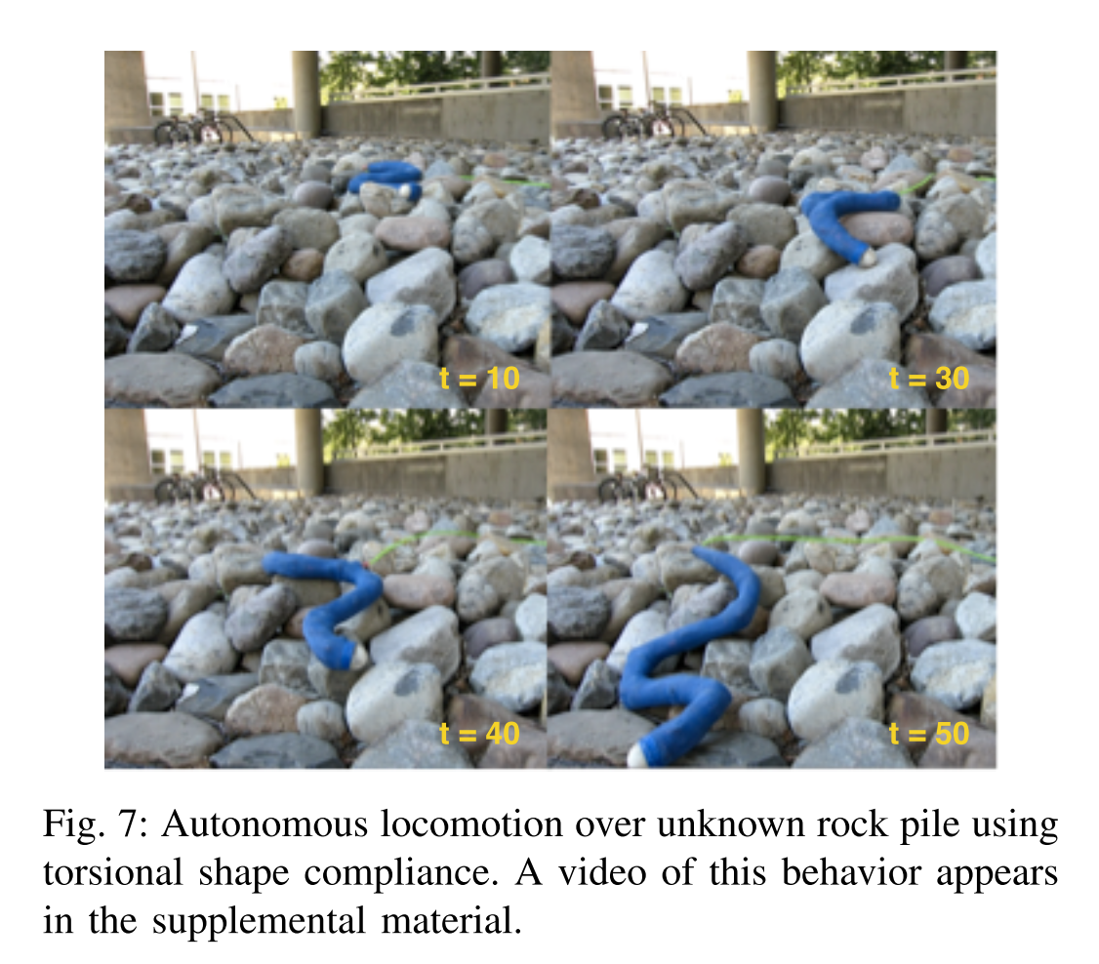
Extension to Three Dimensional Motion

Slide 15
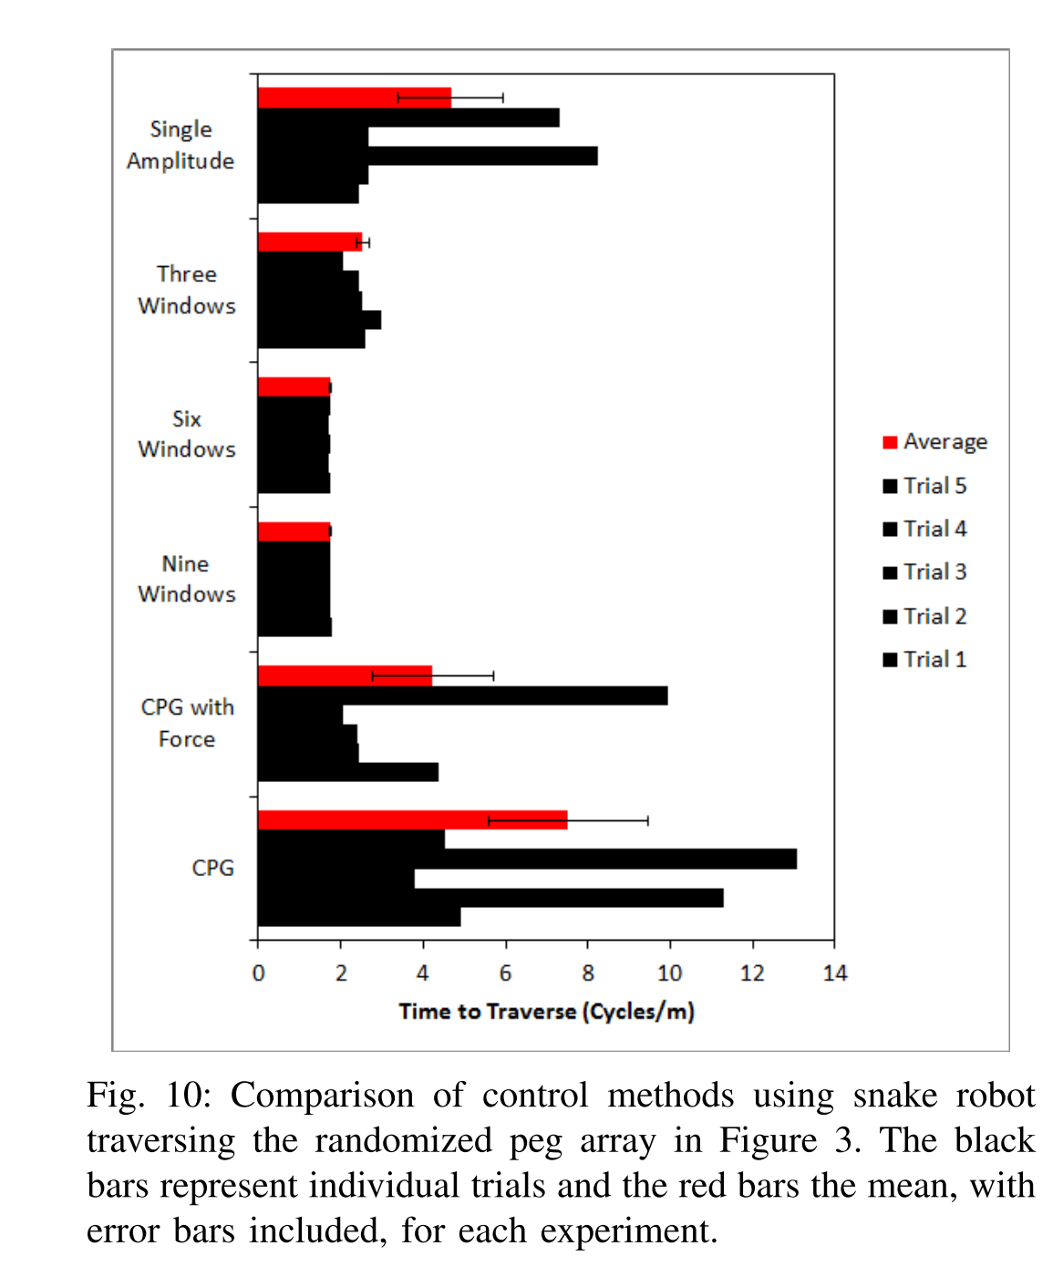
Locomotion Time Results
Notes:
“CPG with force” experiment, the CPG model in [7] was modified such that the stabilizing amplitude dynamics in the oscillator equations were augmented to include an “amplitude force” equal to that used in the nine-window shape controller,i.e., Fσ = Jτext−Foffset
The resulting amplitude dynamics for the forced CPG controller were thus equivalent to those used in the shape-based compliant control implementation
The only practical difference between the forced CPG control and the nine window shape-based compliance was that the shape- based controller used traveling spatial windows where the CPG approach had windows fixed at the joint positions.

Slide 16
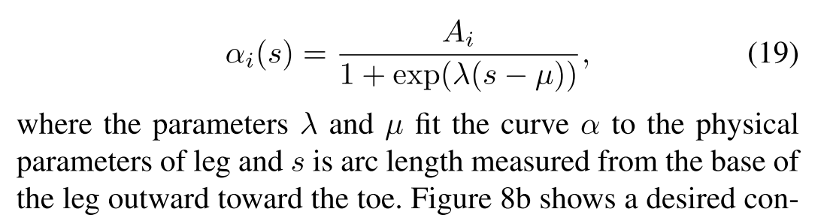
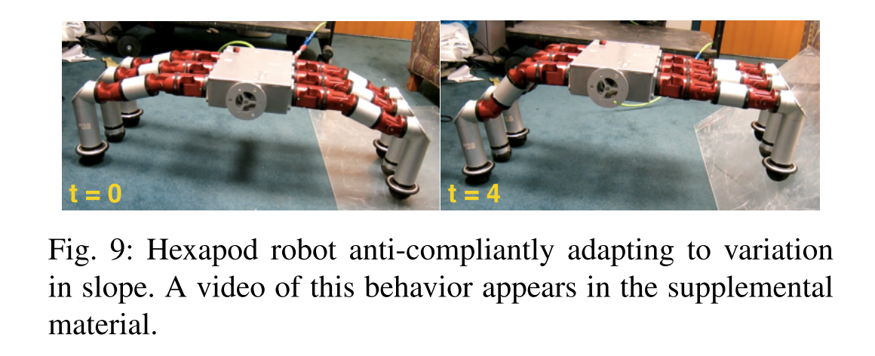
Hexapod Robot Shape Model
Shape Parameters:
Shape bases: β = [-1, 1]

Slide 17
Hexapod Robot Compliant Locomotion

Slide 18
Questions?

